Slide 1



Biogas Production from Microalgae following Freeze-Heat Pretreatment
Galen Dennis
Advisor: Dr. Terry Baxter – NAU College of College of Engineering, Informatics, and Applied Sciences
Arizona Space Grant Consortium Symposium
17 April 2021

Slide 2
Purpose and Applications
System diagram for growing algae in a space vessel
Relevance
Biosystems are effective for gas and nutrient recycling
Long-distance space travel requires efficient recycling systems
Project Question
Preheating increases anaerobic digestion efficiency, does pre-cooling have any noticeable effects?
  Based on the observation that frozen algae samples are much less viscous after defrosting.
Interior 25 ⁰C
Vacuum < -100 ⁰C
Fuel
Anaerobic Digesters
CO₂
Incubator
Nutrients
Oxygen
Biomass
Exhaust Heat > 25 ⁰C

Slide 3
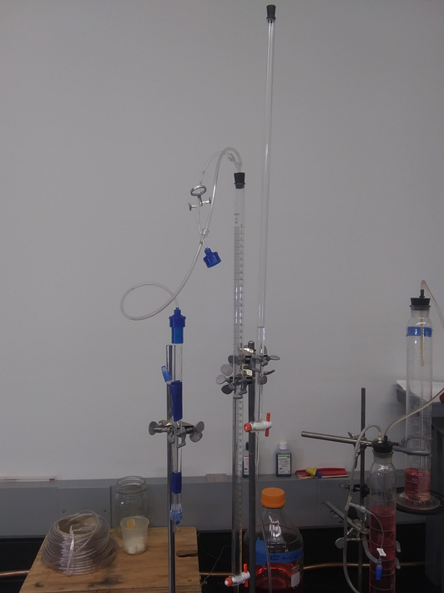
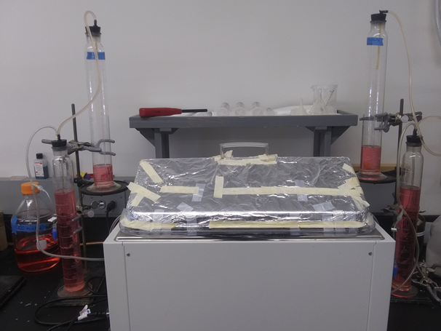
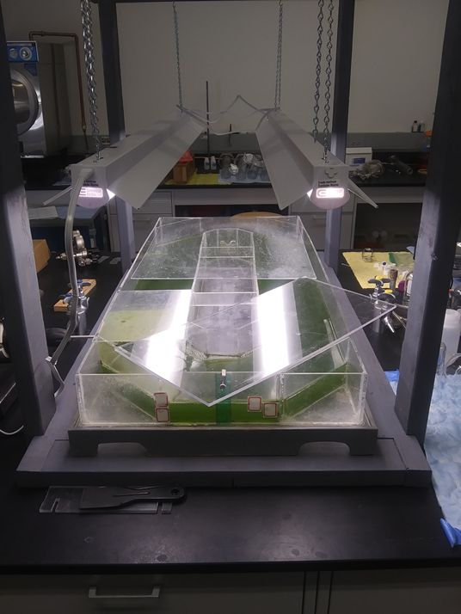
Experimental Methods
Pretreatment Approach | Potential Treatments
Hot | Heating (70 ⁰C), boiling (100 ⁰C), autoclaving (120 ⁰C)
Cold | Freezing (0 ⁰C), Below Freezing (-40 ⁰C), liquid nitrogen (-196 ⁰C)
Cycles | Boil-Freeze, Liquid Nitrogen-Autoclave… etc.
Biomass
Biogas
300 mg/L
15000-30000 mg/L
3-7 days of production
Concentration
Algae Bioreactor Raceway
400 mL Anaerobic Digesters
CO₂ Scrubber

Slide 4
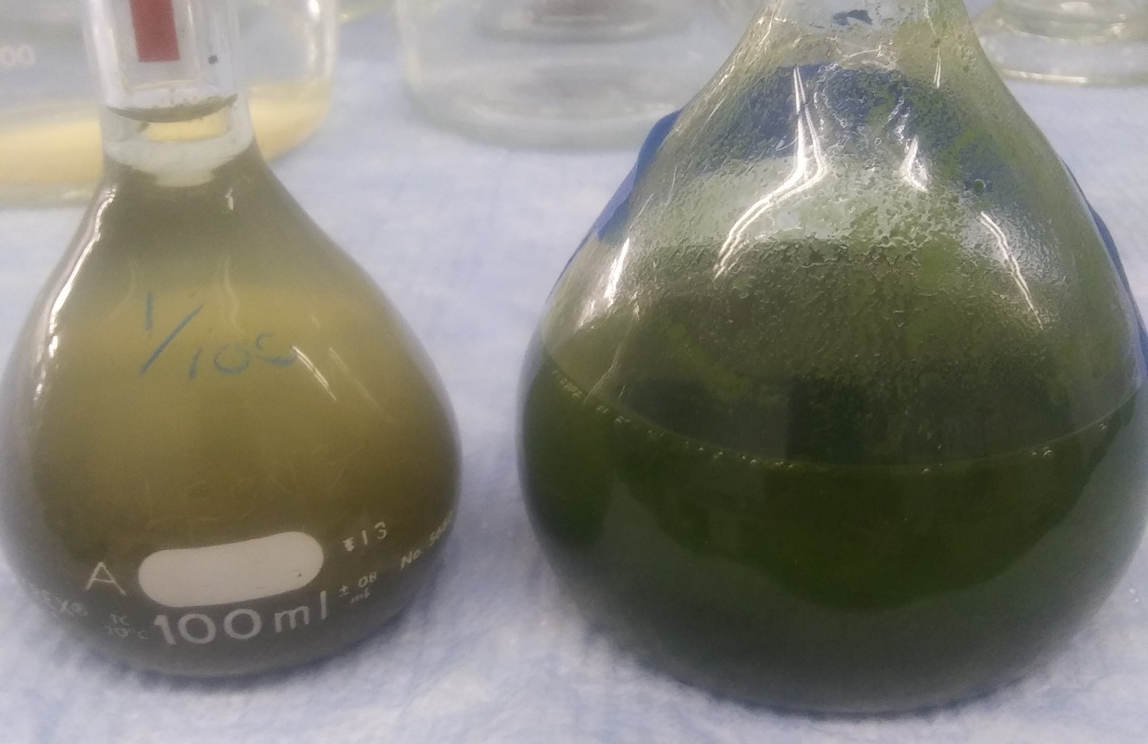
Results
Heat-treated (left) and untreated (right) algae
Assumptions
10 % of biomass is retained by digesters
The product biogas is pure methane
Digesters will have the same relative response to the same feed

Slide 5
Results

Slide 6
Conclusions
Heat pretreatment led to improved overall gas production, and methane content
What’s left
  Cold pretreatment
  Cold-hot cycles
  Hot-cold cycles
Improvements
  Maintain pH
  Standard testing lengths
  Multiple test and control digesters

Slide 7
Thank you
Acknowledgments
Dr. Terry Baxter
NAU Environmental and Civil Engineering Department - Biotechnology Lab
NAU NASA Space Grant Internship
Arizona Space Grant Consortium

